Slide 1
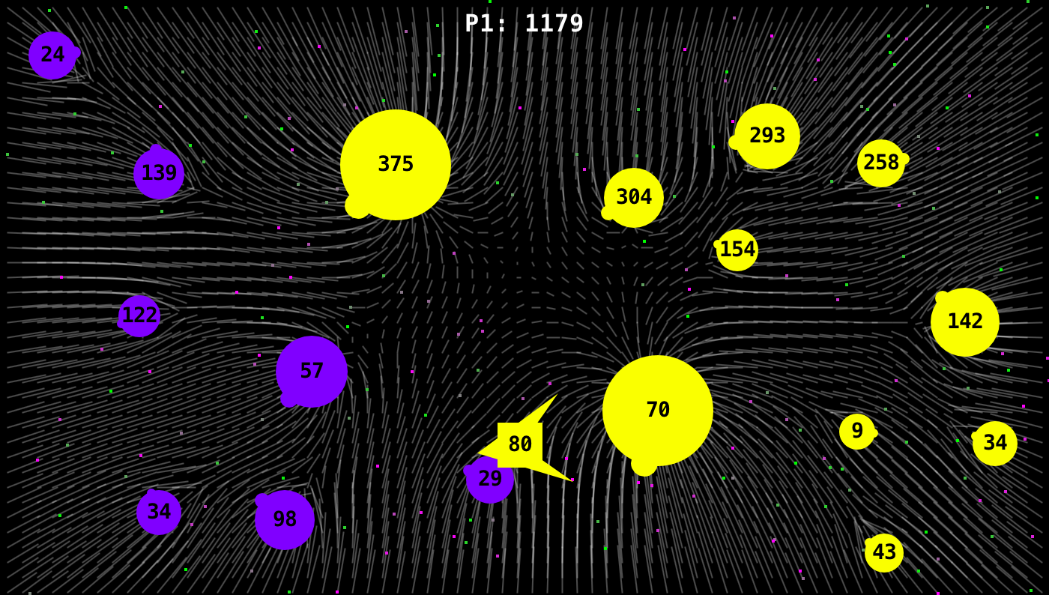
Game Design Spaces IGGI Games Design II
Simon Lucas and Diego Perez

Slide 2
Ambitious Searchable Design Spaces
Togelius and Schmidhuber (CIG 2008)
Cook and Colton (CIG 2011, …)
The above were ambitious in the open-ended nature of the rules – but the games had limited variations in the physics
Even more open-ended:
Video Game Description Language
Ebner at al Dagstuhl 2012, Schaul CIG 2013)
All interesting work
Difficult to auto-generate good quality human-playable games

Slide 3
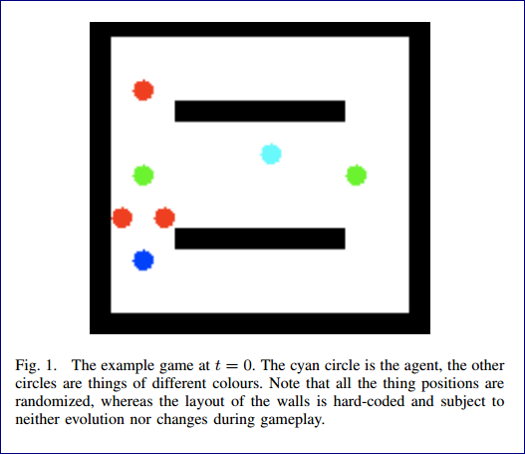
Togelius and Schmidhuber
Three items:
* Set of numerical parameters
* Table of collision effects
* Table of collision scores
Evaluation was complex: how well could agents learn to play a game?
Inspiring work, but results were restricted by the cost of each fitness evaluation, and the learning ability of the algorithms
Current approach would more likely be MCTS-based

Slide 4
The Devil is in the Detail
The big picture is important as well, BUT:
Tuning the details has a massive effect on playability of a game
We can separate out the identifying and setting of the detailed parameters
From measuring the effects of particular combinations of settings
The details can be hand tuned or automatically tuned
How can we measure the quality of a game?
Human play testing
Measuring experience of AI bots

Slide 5
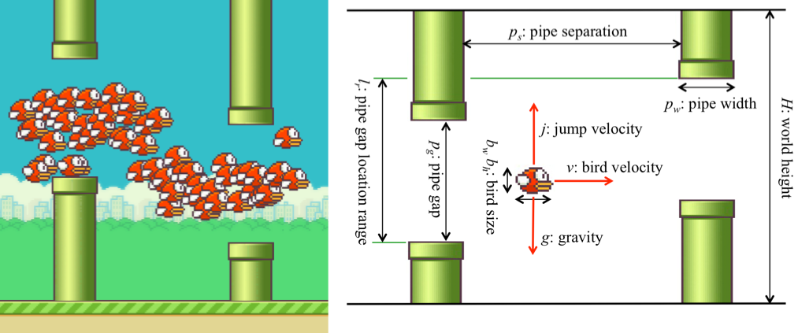
Searching a Flappy Bird Design Space (work by Aaron Isaksen et al @ NYU)
Interesting approach:
Identify a number of numerical parameters
Search for combinations of parameters that lead to playable games

Slide 6
What is a playable Flappy Bird game?
A simple but near optimal AI player is used with a small amount of random noise
The noise is used to vary the “tap time” (i.e. the exact game tick that the screen tap event is sent)
A playable game is defined as one where the percentage of “birds” achieving a minimum degree of progress is within a specified range

Slide 7
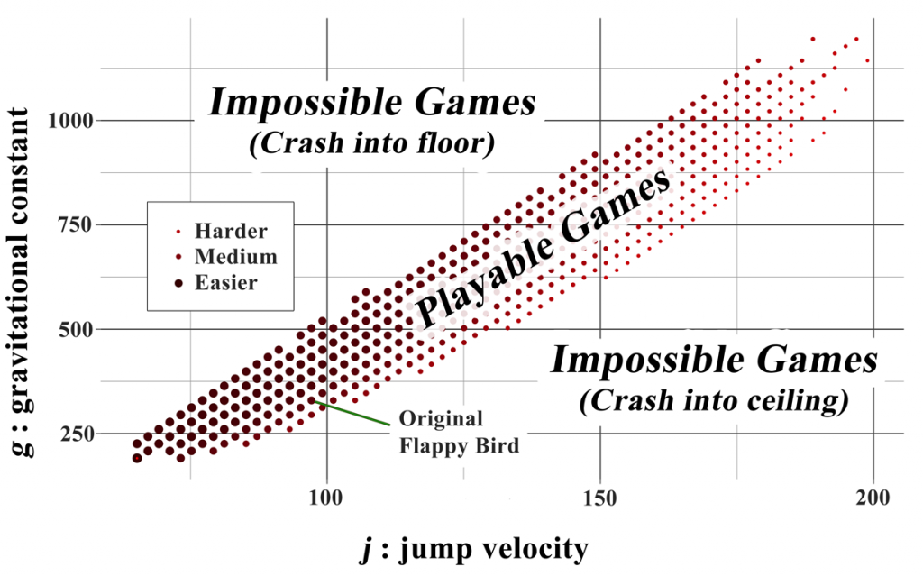
Searching the game space
After searching for playable games and clustering them
Different clusters led to games with a significantly different feel, even though the rules were the same
See link for more info

Slide 8
Comments on Isaksen’s Work
Excellent example of doing interesting work with simple AI
Uses games for which the development of an optimal or near-optimal AI is possible (perhaps even easy)
Then adds noise to the actions of the AI bots to simulate weaker play and human error
Noise can be added to vary the time
Can define the standard deviation of the added noise
Very cool!!!

Slide 9
Searchable Game Design Spaces

Slide 10
Constructing a Searchable Game Design Space Approach: Identify Characteristic Dimensions of a Game Genre e.g. 2-D Arcade Games

Slide 11
Approach: Identify Characteristic Dimensions of a Game Genre e.g. 2-D Arcade Games
Game rules
Object types
Vehicle physics
Input controls
Weapon systems
Game views
Level designs
AI Behaviour

Slide 12
Game Rules
What happens when things collide? (define in Collision Matrix)
Reward structure (points, lives/health/ammo gained and lost)
Game state transition structure (e.g. when is a level cleared?)
These are fundamental to the nature of the game
Small changes can radically alter the game
For example, flipping the sign on a reward signal

Slide 13
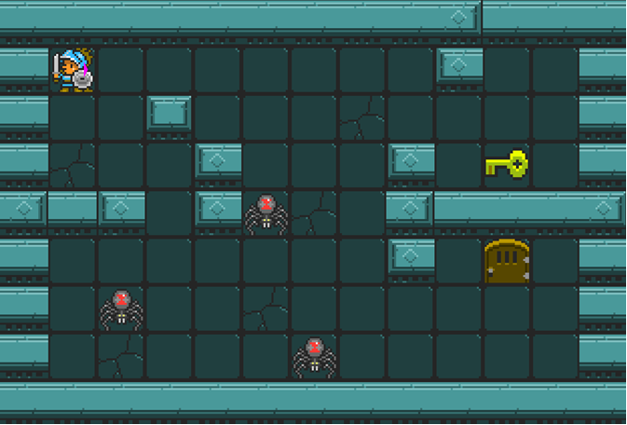
Object Types
Things to:
Shoot
Collect
For reward
Or power up / health
Jump on
Protect
Infect
Bounce off

Slide 14

Vehicle Physics
How do actions affect the movement of the vehicle (space ship)
Left-right?
Car-like?
Asteroids-style space ship
Thrust forward / reverse
Thrust always on? (this is an interesting twist)

Slide 15
Input Controls
Related to vehicle physics but distinct
How is the ship / game controlled
E.g. Classic arcade versus one tap or one touch (let’s say with one-touch the duration of touch counts too, as well as the timing of the touch)
Can also vary the input mode completely
E.g. Tap-based Pac-Man where each tap gives Pac-Man an aim-point

Slide 16
Weapon Systems
Things to vary include:
Firing rate (and cannon cool down)
Missile velocity profile
How fast does it travel
And does it slow down (like a bullet) or speed up (like a rocket)
Missile range
Missile steer
(make ship movement steer the missile – like Galaxians)

Slide 17
Game Views
Fixed versus panning / scrolling / zooming viewport)
2D versus 3D, fully versus partially observable
Note that this can radically alter the nature and difficulty of a game
In game theory terms may also be significant e.g.
Transform a game of perfect information into a partially observable one (and an MDP into a POMDP)
What about Lights-Out Space Battle
Play without seeing anything – except the score!
Actually an already studied game: Kriegspiel

Slide 18
Level Design
This obviously has a significant impact on the difficulty and interest of a game
Ms Pac-Man is a classic example
Where levels differ in maze layouts
And also in the parameters (edible time, speed of Ms Pac-Man and speed of Ghosts)
For Asteroids exercise focus on speed, size and movement (and possibly nature) of the Asteroids

Slide 19
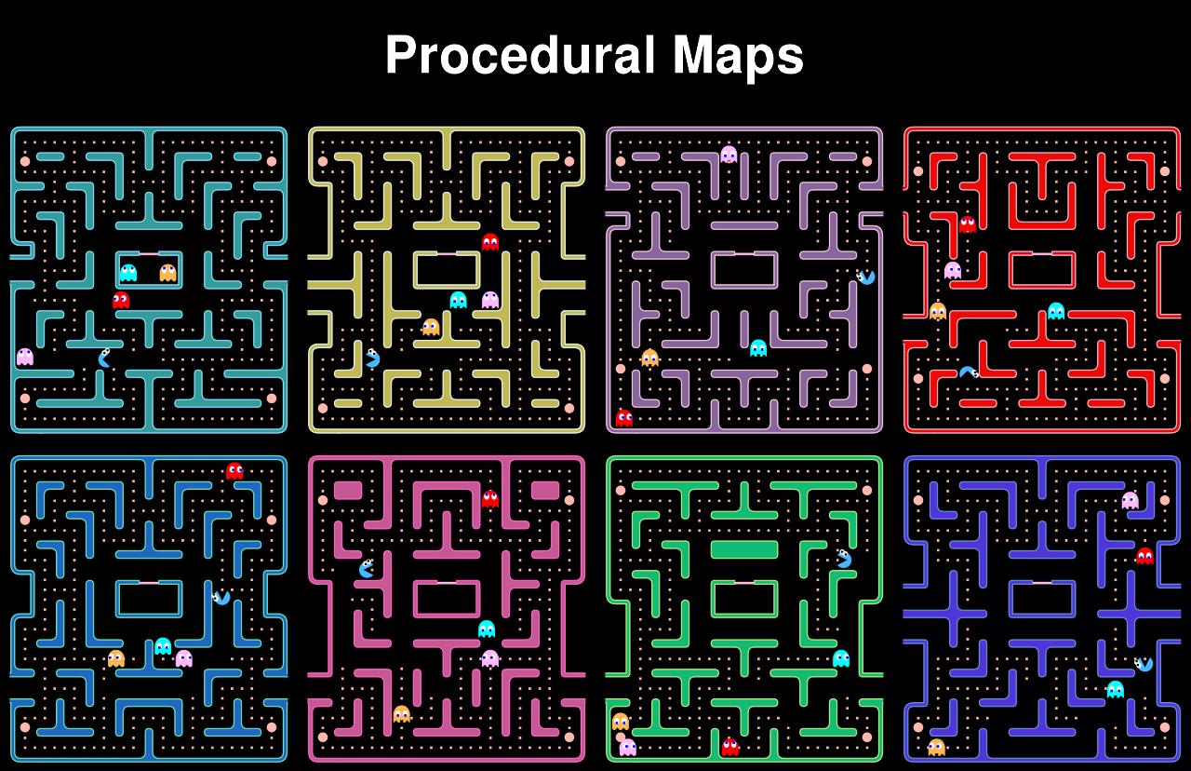
Ms Pac-Man Example

Slide 20
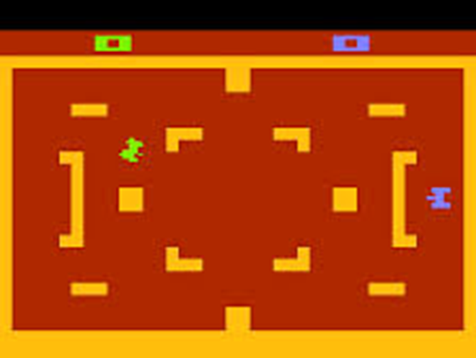
AI Behaviour
This can be a big and complex one
But we’ll experiment with powerful AI on this course
To help manage the complexity
Good AI can make for a very engaging experience – for even a simple battle game
E.g. Atari Tank Battle was brilliant – to play against a human opponent (in this case HI instead of AI)

Slide 21
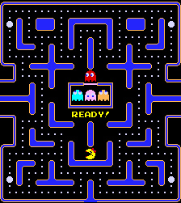
Pac-Man Example: What to tune?
Which aspects of Ms Pac-Man could be easily tuned?
i.e. parameters that could be identified or easily invented and varied

Slide 22
Game Tuning
We made a change:
Can the difference be detected? How?
Hole detection / exploits?
Entropy changes?
More drama? (e.g. more flux in obvious measures?)
Can we learn a new strategy?
Make better bots?
Can GUI frustration be measured?
Analysed touch events, near misses?
Bot Id Detection?

Slide 23
Objective measures of game-play (and automating the measurements)
The automatic part comes from having AI-bots play through a game
What we measure will depend on the bots
Different bots may give rise to VERY different measurements
If we can use General AI (e.g. GVGAI) bots, then we have a ready supply of play testers

Slide 24
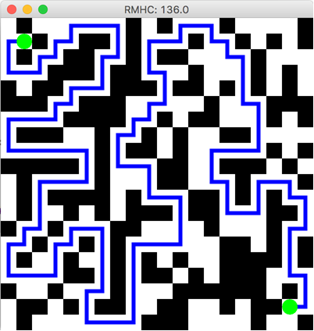
Can also use other measures of a game – don’t always need bots
This maze was evolved
Random Mutation Hill Climber (RMHC) and (1+1) ES
Representation:
Bit vector of length 400 (20 x 20)
Fitness measure: longest shortest path between the two green dots

Slide 25
Examples from the literature
We’ve already seen Flappy Bird example (Isaksen)
Consider also:
Frayn (Monopoly) – just an analysis
Togelius et al (Car racing)

Slide 26
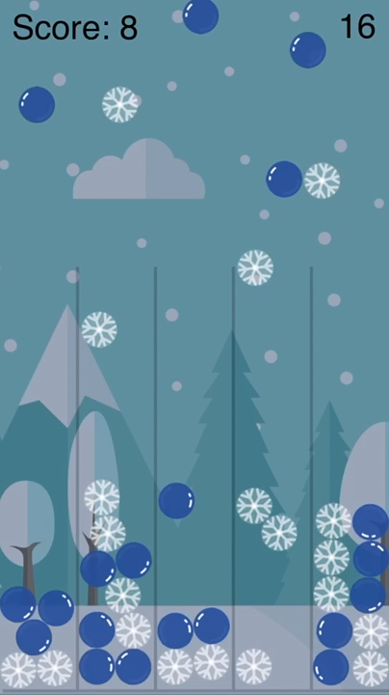
Let it Snow

Slide 27
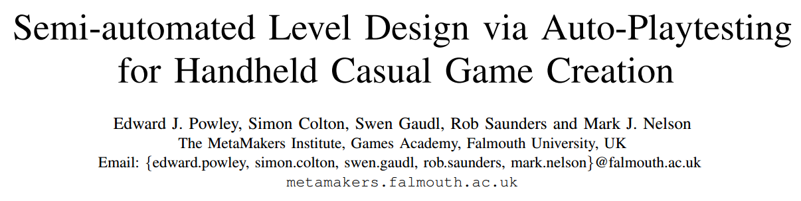
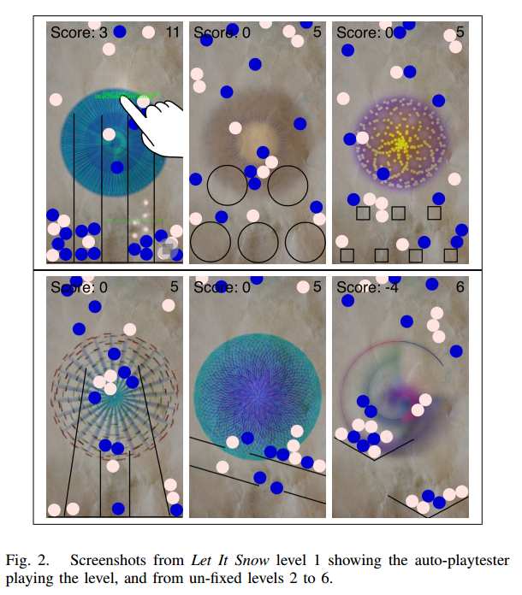
Used auto-play testing to provide feedback for game designer

Slide 28
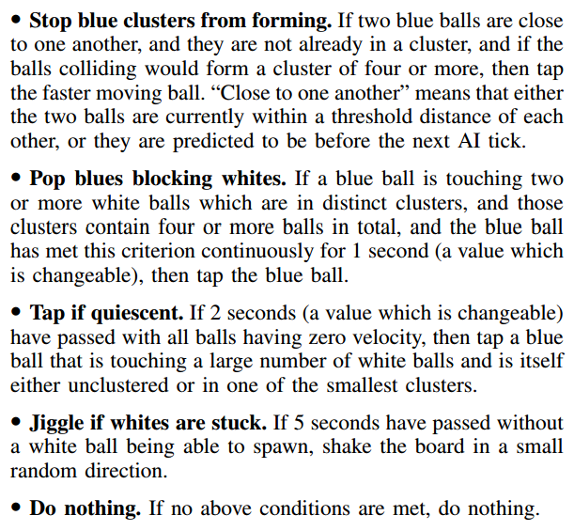
Used a Heuristic AI
Rules fire in priority order
Designer given quick feedback

Slide 29
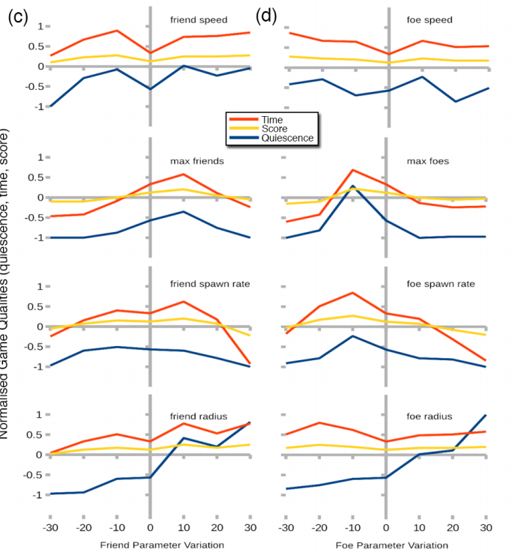
Designer can watch game play and study graphs
Effects of varying parameters can be observed
Compared with designer’s ideal values

Slide 30
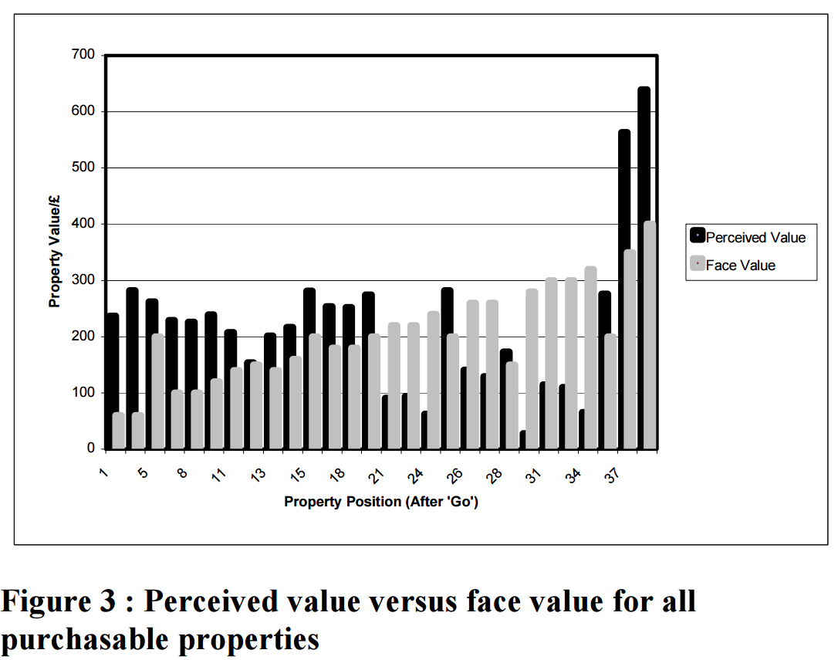
Monopoly (Frayn, IEEE CIG 2006)
Used evolved bots to model players
And estimate true value of properties
Very different to results of a simple Markov chain analysis

Slide 31
Discussion Question
In a game such as Monopoly, should the face value differ from the real value?

Slide 32
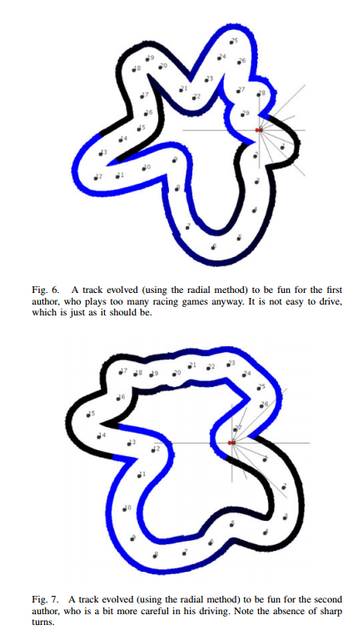
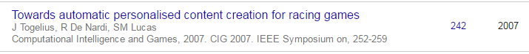
Imitation Learning for Track Tuning Togelius, De Nardi and Lucas, IEEE CIG 2007
Player data was captured from players
Imitation learning to train bots to drive like players
Bots then used to play test tracks
To provide required level of difficulty for each player type (e.g. Julian, top, Renzo, bottom)

Slide 33
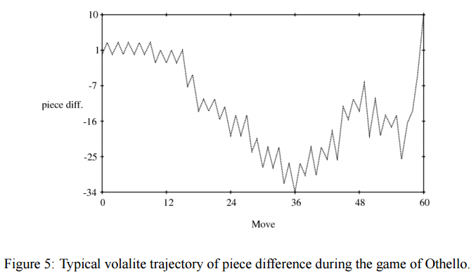
Evolving for Drama
Tuning for dramatic outcomes
Othello: good example of game with drama

Slide 34
Summary
Games have parameters
They can and should be tuned
Do this manually using your own insight
And also try to do it automatically
Using available or invented metrics
And play-testing by AI bots

